Slide 1


Commit Command in GIT
Presented By : RISHIVANT SINGH

Slide 2
Contents
Introduction
Uses of Commit
My Work On Commit
.
Conclusion

Slide 3
What is Git?
Git is a version control system .Git is a mature, actively maintained open source project originally developed in 2005 by Linus Torvalds, the famous creator of the Linux operating system kernel. Git is software for tracking changes in any set of files, usually used for coordinating work among programmers collaboratively developing source code during software development. Its goals include speed, data integrity, and support for distributed, non-linear workflows (thousands of parallel branches running on different systems)
Trusted
Innovative
Popular
Trusted by all the developers worldwide.
Its innovation has led to easier practice of development with full security
Its popular among all the companies, developers and programmers in the entire industry..

Slide 4
Commit IN GIT
?
Commit in git:-
The git commit takes the snap of the currently staged changes of the project.
Committed snaps are the safe version of project
.
Commits helps in tracing the history of the repository and that history tells us how it is the way right now.
Commit includes meta data that is data of data of the repository.
It also includes timestamps , Authors , and many more things that help us to get the complete history of the work that has been done on the repository.

Slide 5

Various Commands of Commit
Git commit
- It will create a commit which is the snapshot of the repository. It will open a text editor which will ask for a message and once we save it commit will happen.
Git commit –a
- It commits the snap of all the changes in the working directory. It includes the various changes of tracked files.
Git commit –m “ message “
- It is a better version of git commit because while commiting it takes a message also which prevents the opening of a text editor. It takes an inline message along with it.
Git commit -am “commit message”
- This is a combination of –a and -m git. It takes the snap of all the changes with an inline message.
Git commit – amend
- This option adds another level of functionality to the commit command. Passing this option will modify the last commit. Instead of creating a new commit, staged changes will be added to the previous commit. This command will open up the system's configured text editor and prompt to change the previously specified commit message.

Slide 6
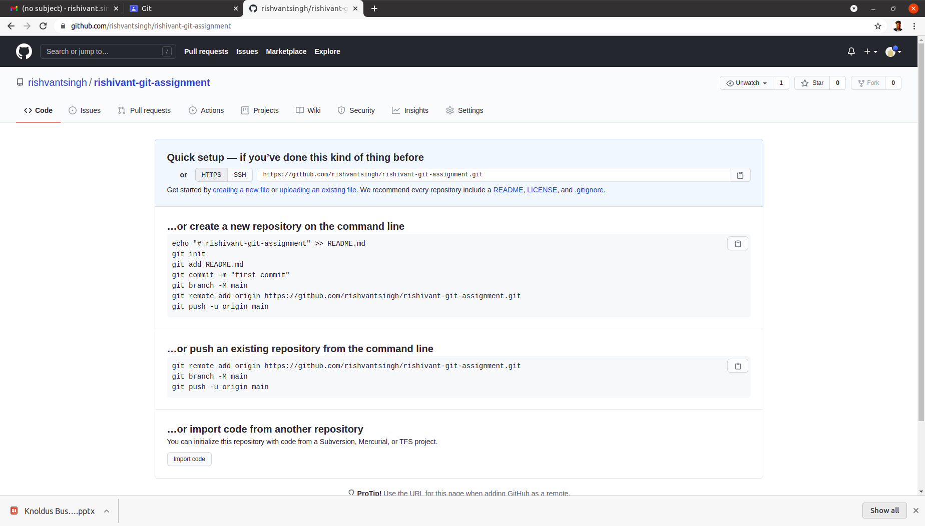

Steps for pushing the file in git repository .
- Made a git repository

Slide 7
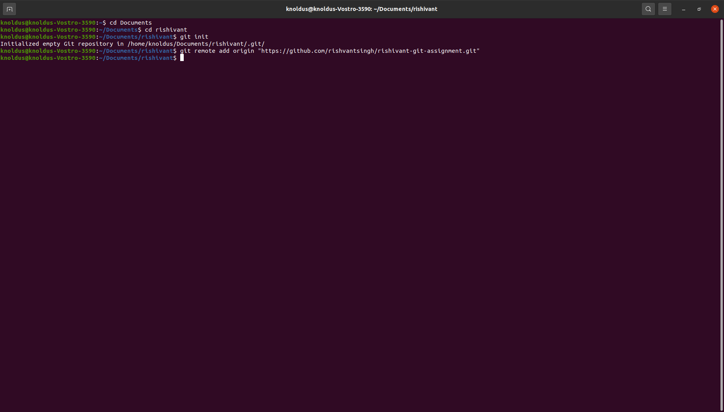
2 – Gave command for pushing the file in repository

Slide 8
Other command for inserting the file
git init
git commit -m "first commit"
git remote add origin https://github.com/rishvantsingh/rishivant-git-assignment.git
Git add .
Git commit -m “message”
git push -u origin main
Link for the assignment - link

Slide 9

Thank You!

